Slide 1
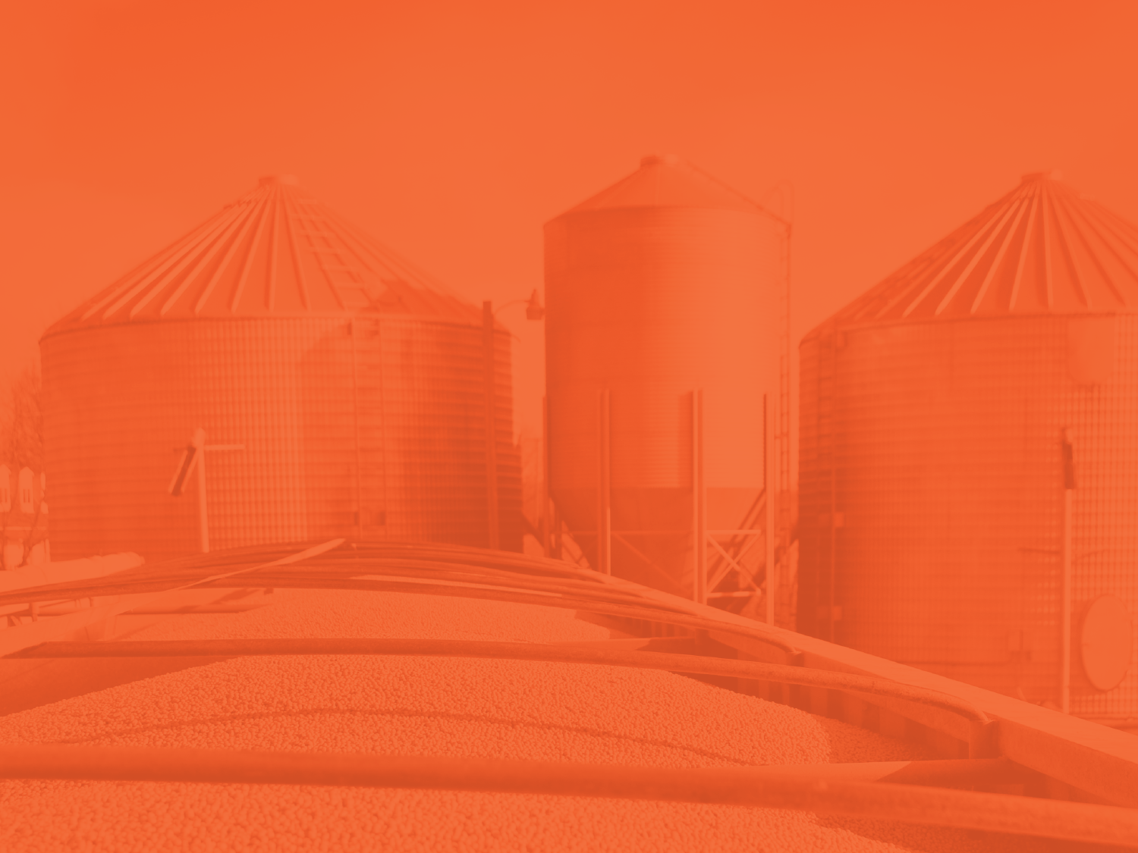
FIELD TO MARKET OVERVIEW
© 2022 Field to Market. All rights reserved.
www.fieldtomarket.org

Slide 2
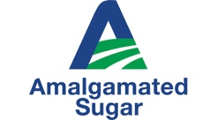
UNITING THE FOOD AND AG VALUE CHAIN
Uniting the Supply Chain to Deliver Sustainable Outcomes for Agriculture

Slide 3
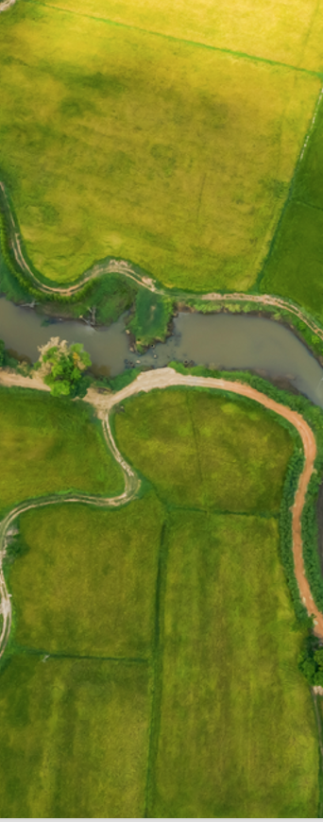
FIVE DIVERSE MEMBERSHIP SECTORS
GROWER
CIVIL SOCIETY
AGRIBUSINESS
AFFILIATE
BRANDS & RETAIL
INSIHT Offering sustainability insights
for farmers and transparency for
value chain partners through
measurement

Slide 4
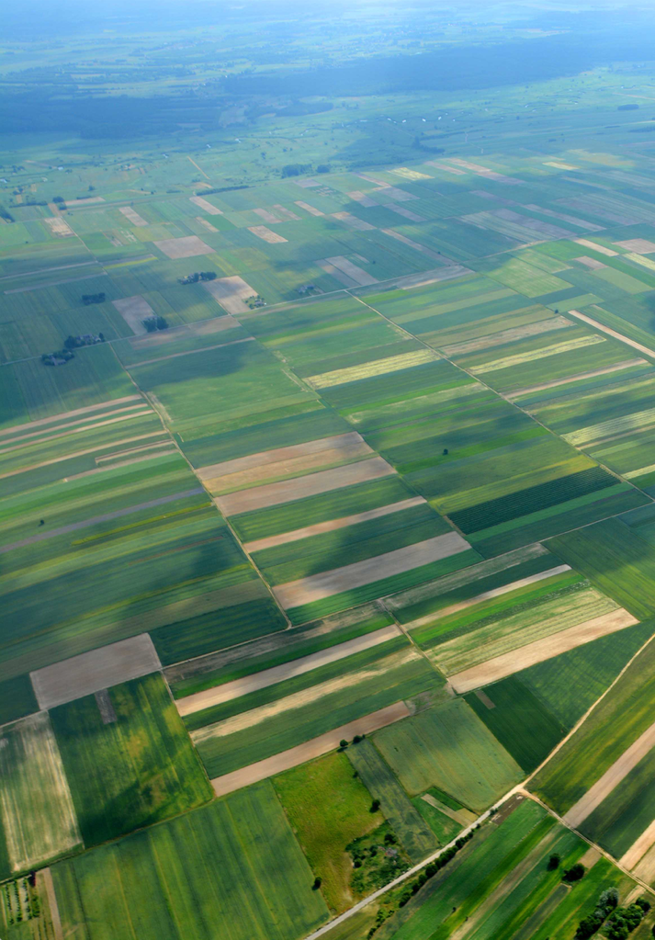
FIELD TO MARKET
GROUNDED IN SCIENCE
QUANTITATIVE OUTCOMES-BASED TECHNOLOGY NEUTRAL

Slide 5
FIELD TO MARKET
Alfalfa
Barley
Corn (for Grain and Silage)
Cotton
Peanuts
Potatoes
Rice
Sorghum
Soybeans
Sugar Beets
Wheat
Eleven Crop and Feed
Pathways

Slide 6
FIELD TO MARKET
Current Sustainability Metrics
Analyzing multiple metrics simultaneously enables farmers to consider trade-offs across
sustainability outcomes:
Biodiversity
Energy Use
Greenhouse Gas Emissions
Irrigated Water Use
Land Use
Soil Conservation
Soil Carbon
Water Quality

Slide 7
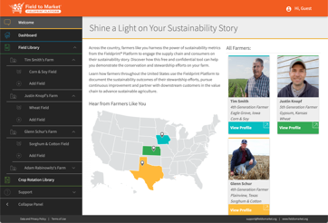
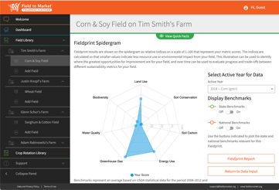
THE FIELDPRINT PLATFORM
Notes:
The Fieldprint Platform benefits the entire agricultural value chain, from the farm gate to the retail and restaurant counter.

Slide 8
FIELD TO MARKET
TRANSLATING SCIENCE INTO ACTION
Backed by the industry’s leading pre-competitive sustainability measurement framework, Field to Market’s Continuous Improvement Accelerator supports farmers and organizations in making decisions based on science, enabling the entire value chain to catalyze action across the agricultural landscape.

Slide 9
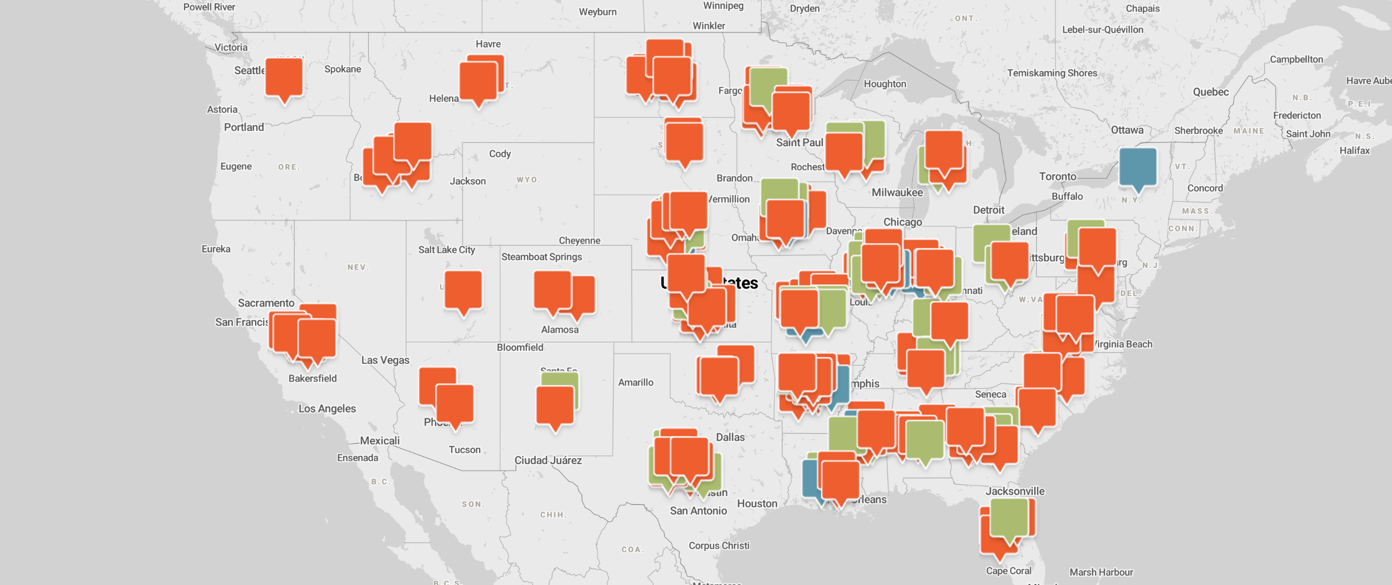
Notes:
We currently support more than 70 active projects across the U.S., each one of which is harnessing our science-based tools and committed partners to drive change for farmers in their region.
And we’re especially proud of the green pins you see on the map – which represent those projects that are committed to providing financial and technical assistance to farmers.

Slide 10
CONTINUOUS IMPROVEMENT ACCELERATOR
Three Continuous Improvement Pathways
INCUBATION Creating enabling conditions by
engaging with farmers on the
connection between practices and
at least one sustainability indicator
INSIGHT Offering sustainability insights
for farmers and transparency for
value chain partners through
measurement
INNOVATION Provides tangible support for farmers in accelerating adoption of practices that deliver improved sustainability outcomes consistent with public project goals

Slide 11
CONTINUOUS IMPROVEMENT ACCELERATOR
Field to Market Has Enabled Five Claims Categories
PROJECT PARTICIPATION CLAIM
ADOPTION CLAIM
MEASUREMENT CLAIM
TRENDS CLAIM
IMPACT CLAIM
Number of acres and growers
Uptake of a specific practice or intervention
One-year snapshot of aggregate environmental outcomes
Directional improvement in Field to Market’s metrics
Sustained Improvement in Field to Market’s metrics

Slide 12
FIELD TO MARKET
www.fieldtomarket.org

